Slide 1



IT 493 Assignment 7
Test Plan with Test Script
Test plan & Use Case
Tour Catchers LLC
Team 4

Slide 2
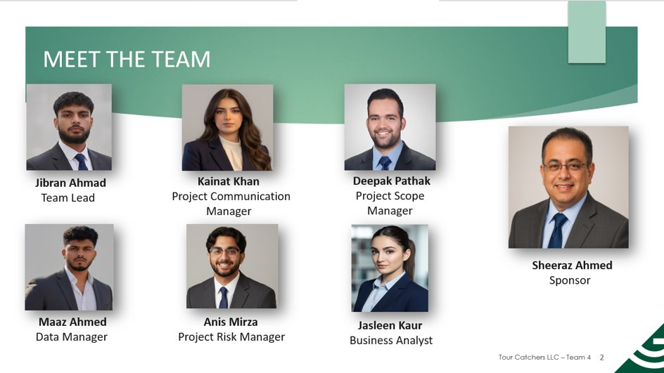

Slide 3
Agenda
Designing Our Testing
Uses Cases

Slide 4
Objective Of Our Test Plan
Design Our Testing
Use Cases
Citation & refrence
Test Plan
Web Booking Application
Dailpad AI Integration
Bitrix CRM Configuration
Security & Data Integrity

Slide 5
In Scope Of Our Test Plan
Design Our Testing
Use Cases
Citation & refrence
Test Plan
Booking Management
Payment Processing
AI Support Workflows
CRM Data Sync

Slide 6
Out Of Scope For Our Test Plan
Design Our Testing
Use Cases
Citation & refrence
Test Plan
Vendor Infrastructure
Marketing
Data Migration of Unstructured Records

Slide 7
Testing Methodology
Design Our Testing
Use Cases
Citation & refrence
Test Plan
Functional Testing
Integration Testing
System Testing
User Acceptance Testing

Slide 8
Test Environment
Design Our Testing
Test Plan
Citation & refrence
Use Case
Sandbox Environment
Local Development Environment
A cloud-based replica used for integrated testing without risking live data.
Pos :Controlled setting; no disruption to current operations
Cons: Requires stable internet; limited by third-party API constraints
Individual setups on each team member's machine for initial coding and module testing
Pros: Enables rapid setup and immediate feedback
Cons: Inconsistent machine configurations, Lacks the full scope and connectivity

Slide 9
Test Equipment
Design Our Testing
Test Plan
Citation & refrence
Use Case
Hardware Requirement
Software & Framework
Standard Laptops
Mobile Devices
Network Gateway & Routers
Microsoft Excel
API Testing Tools
Bitrix24 and Dialpad AI Cloud Platforms
9​

Slide 10
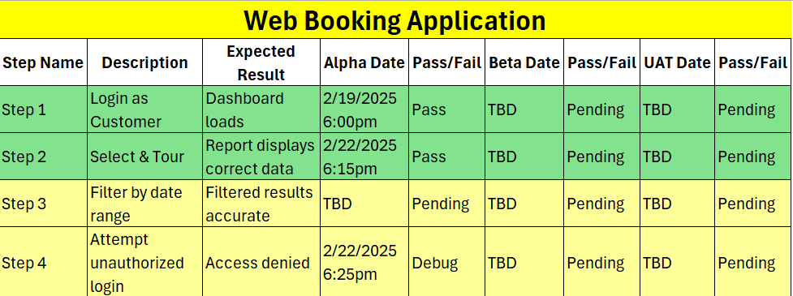
Design Our Testing
Test Plan
Citation & refrence
Use Case
Test Plan
9​​

Slide 11
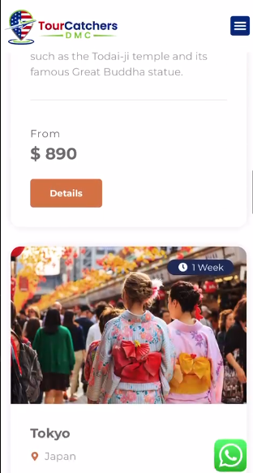
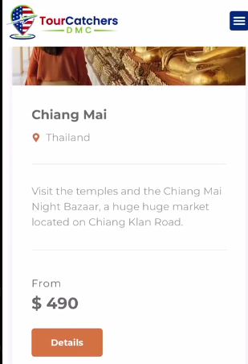
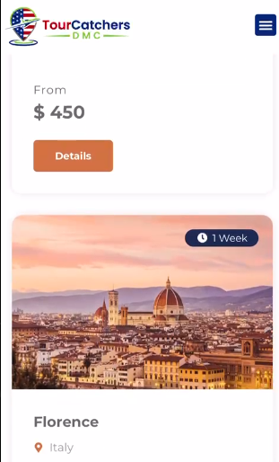
Test Plan
Design Our Testing
Test Plan
Citation & refrence
Use Case
10

Slide 12
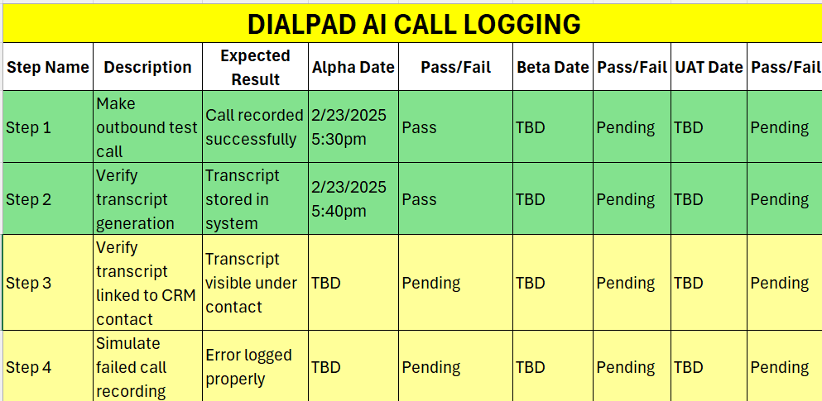
Design Our Testing
Test Plan
Citation & refrence
Use Case
Test Plan
11

Slide 13
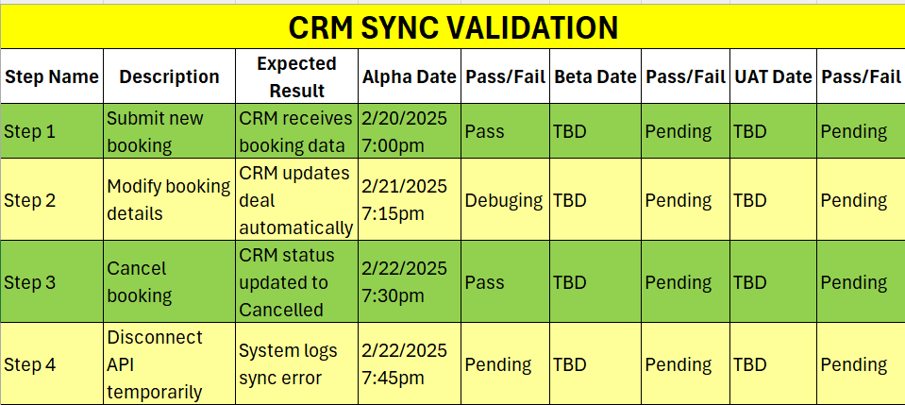
Design Our Testing
Test Plan
Citation & refrence
Use Case
Test Plan
12

Slide 14
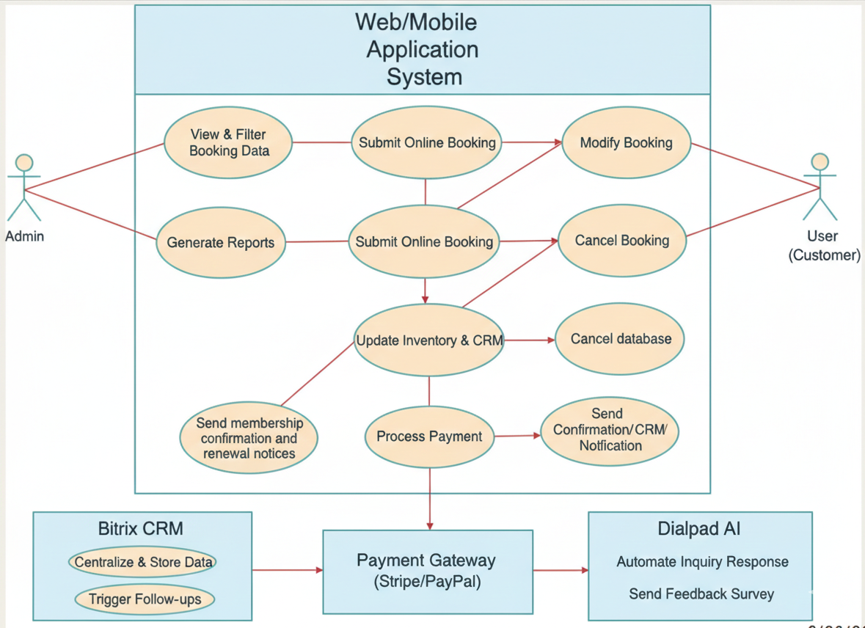
Section 2 Use Case
Design Our Testing
Test Plan
Citation & refrence
Use Case
13

Slide 15
Web Booking Application
Design Our Testing
Test Plan
Citation & refrence
Use Case
Use Case | Submit Online Booking
Business Actor | Customer
Pre- Condition | The customer has a stable internet connection and is on the official website.
Basic Flow | The customer selects a tour package and a specific travel date. The system queries the database to verify real-time availability. The customer enters their personal details and payment information. The system authorizes the payment through the Stripe/PayPal gateway. The system updates the inventory count in the CRM and displays a "Success" page with a confirmation receipt.

Slide 16
Web Booking Application
Design Our Testing
Test Plan
Citation & refrence
Use Case
Use Case | Modify Existing Booking
Business Actor | Customer, Admin
Pre- Condition | The customer has a valid, existing booking ID in the system. The customer is within the allowed modification window (e.g., 48 hours before departure)
Basic Flow | The customer accesses their reservation through the "Manage Booking" portal. The customer selects a new travel date or updates personal details. The system checks Bitrix CRM for real-time availability on the new requested date. The system updates the reservation details and sends a revised confirmation email. The inventory is adjusted in the CRM (returning the old spot and reserving the new one)

Slide 17
Web Booking Application
Design Our Testing
Test Plan
Citation & refrence
Use Case
Use Case | Cancel Booking
Business Actor | Customer, Admin
Pre- Condition | A confirmed booking exists in the Bitrix CRM database. The customer provides the correct booking reference and email for verification.
Basic Flow | The customer requests a cancellation via the web portal. The system confirms the cancellation request against the company policy. The system marks the booking status as "Cancelled" in the CRM. The system automatically releases the spot back into the "Active" inventory for other customers. A cancellation confirmation and refund notification (if applicable) are sent to the customer.

Slide 18
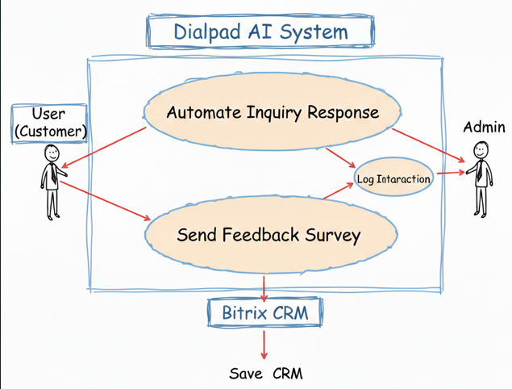
Dialpad AI
Design Our Testing
Test Plan
Citation & refrence
Use Case

Slide 19
Dialpad AI
Design Our Testing
Test Plan
Citation & refrence
Use Case
Use Case | Automated Inquiry Handling
Business Actor | Customer, DailPad
Pre- Condition | The Dialpad AI module is active and integrated with the website chat/phone lines. The customer have open TourCatchers website and click to Dailpad.
Basic Flow | A customer submits a question (e.g., "Do I need a visa for the Nepal tour?") via the chat widget or voice line. The AI analyzes the intent and retrieves the relevant answer from the knowledge base. The AI provides an instant, accurate response to the customer. The system logs the interaction summary directly into the Bitrix CRM as a lead or activity.

Slide 20
Dialpad AI
Design Our Testing
Test Plan
Citation & refrence
Use Case
Use Case | Automated Feedback Collection
Business Actor | Customer, DailPad
Pre- Condition | The customer has completed a tour, & status is updated to Completed in the CRM. The Dialpad AI automated messaging trigger is enabled.
Basic Flow | The system detects the tour completion date in Bitrix CRM. Dialpad AI automatically sends a post-trip survey link via SMS or Email. The customer submits their rating and comments through the AI interface. The AI parses the sentiment of the feedback (Positive/Negative). The system saves the feedback scores directly to the customer’s profile in the CRM for staff review.

Slide 21
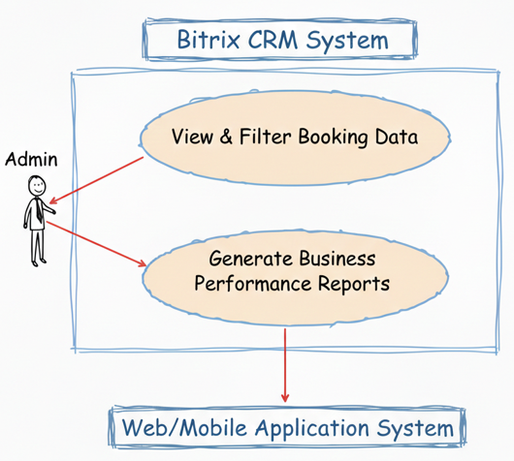
Bitrix & CRM
Design Our Testing
Test Plan
Citation & refrence
Use Case

Slide 22
Bitrix & CRM
Design Our Testing
Test Plan
Citation & refrence
Use Case
Use Case | Centralize and Retrieve Customer Records
Business Actor | Admin
Pre- Condition | The Web Booking App and Dialpad AI integrations are successfully synced with Bitrix24.
Basic Flow | The system automatically captures data from a new booking or AI inquiry. The CRM creates or updates a "Lead" or "Contact" record with the customer's history. The Admin logs into the Bitrix dashboard to view the centralized data. The Admin filters the records to generate a "Tour Status Report" or "Revenue Summary." The system triggers automated follow-up tasks or email reminders based on the tour date.

Slide 23
Bitrix & CRM
Design Our Testing
Test Plan
Citation & Reference
Use Case
Use Case | Generate Business Performance Reports
Business Actor | Admin
Pre- Condition | The Admin is logged into the Bitrix CRM with reporting privileges. Sufficient booking and inquiry data has been synced from the Web App and Dialpad AI
Basic Flow | The Admin navigates to the "Analytics" or "Reports" section within Bitrix. The Admin selects specific parameters (e.g., "Total Bookings for March 2026" or "AI Inquiry Conversion Rate"). The system processes the stored data and generates a visual report (charts or tables). The Admin exports the report as a PDF/Excel file for the sponsor meeting. The system saves the report configuration for future recurring use.

Slide 24
Citations
Khan, K. (2025). IT-492 Assignment 2. Assignment2_IT492_Khan.docx​
Khan, K. (2025). IT-492 Assignment 3. Assignment3_IT492_Khan.docx​
Khan, K. (2025). IT-492 Assignment 4. Assignment4_IT492_Khan.docx​
Khan, K. (2025). IT-492 Assignment 5. Assignment5_IT492_Khan.docx​
Kaur, J. (2025). IT-492 Assignment 6. Assignment6_IT492_Kaur.docx​
Pathak, D. (2025). IT-492 Assignment 7. Assignment7_IT492_Pathak.docx​
Kaur, J. (2025). IT-492 Assignment 8. Assignment8_IT492_Kaur.docx​
Mughal, M. A. (2025). IT-492 Assignment 9. Assignment9_IT492_Mughal.docx​
Mirza, A (2025) IT-492 Assignment 10. Assignment10_IT492_Mirza.docx
Tours Catchers LLC​ – Team 4
Slide 24

Slide 25
References
Bitrix24 (CRM): https://www.bitrix24.com/
Dialpad (AI Communications): https://www.dialpad.com/
Apache HTTP Server: https://httpd.apache.org/
MySQL Database: https://www.mysql.com/
Microsoft. (n.d.). Microsoft 365 Business plans and pricing. https://www.microsoft.com/en-us/microsoft-365/business​
PayPal. (n.d.). PayPal Business solutions for online payments and invoicing. https://www.paypal.com/us/business
Tour Catchers LLC (2026, January). Project Point-of-Contact (Sponsor). Business Stakeholder Meeting discussing manual process pain points. Personal communication.
Tour Catchers LLC (2026, February). Project Point-of-Contact (Sponsor). Online meeting confirming system requirements and test script criteria. Personal communication.
Tours Catchers LLC​ – Team 4
Slide 25

Slide 26

A SINCERE THANK YOU!
TO PROFESSOR HINE AND OUR GTA KIRAN FOR YOUR SUPPORT AND FEEDBACK!
Questions?
Tours Catchers LLC​ – Team 4
26

